Slide 1
AURA Assembly of University research administrators
Sponsored Projects Administration
November 14, 2023
November 14, 2023

Slide 2
AGENDA
New Staff Introductions Kathleen Kreidler
SPA Restructure & Award Processing Update Kathleen Kreidler & Carmen Martinez
NIH Foreign Subaward Requirements Carmen Martinez
SRA Level Up Training – UTHealth Deep Dives Tiffany Sagers
SB17 Extramural Grant & Supplement Opportunities (11:00am) Kevin Morano, Melissa Pifko &William McElhiney
START Changes and Updates Cheri Vonfeldt & Valerie Bomben
Q & A All

Slide 3
New Staff Introductions

Slide 4
New Staff Introductions
If this is your first AURA meeting:
Unmute yourself, turn on your camera, and please tell us
your name
department
role/title
anything else you’d like to share

Slide 5
SPA Restructure & APT Update

Slide 6
SPA Restructure
Why?:
Rapid Growth in Funding (2017-2023) and still going:
SP funding has grown from $213 mil to $402 mil 98% increase
Number of awards has grown from 1,118 to 1,786 (Excluding CTs) 58% increase
Growth in # of contracts 2020 – 2023 10%
Eliminate redundances in award set up and rebalance workload
Align all payroll related processes – PAs to Cost Transfers to Effort Reporting

Slide 7
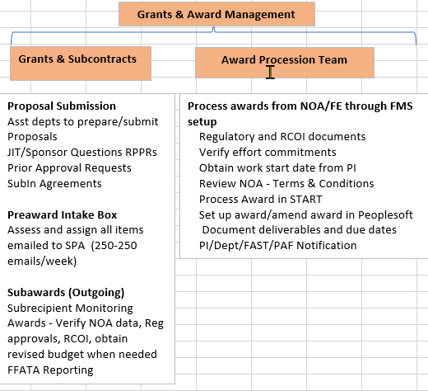
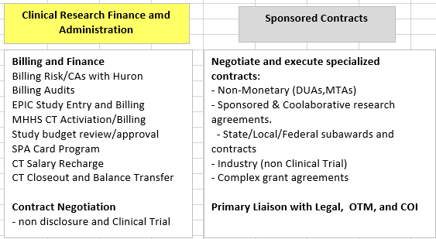
SPA Restructure

Slide 8
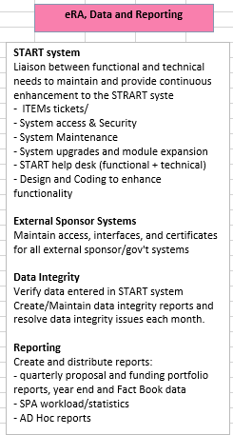
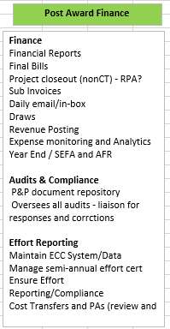
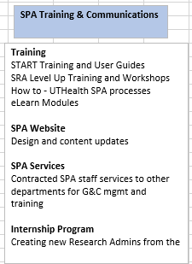
SPA Restructure

Slide 9
Award Processing Team
Award Processing Team began processing awards in March 2023. It was established to reduce award setup times & create continuity for the departments
Awards are assigned to the Team once a NoA is received
Pending Items typically include:
Assurances/RCOI (Project-specific disclosure)
Most RCOIs are completed via UTStart, the APT Specialist can provide guidance on the need for a PDF RCOI form
Updated Budgets
Confirmation of faculty effort and Work Start Date
Subcontract SOWs
APT Specialist will notify all Faculty/departments by email once the FMS is ready for use
Goal is to reduce CTMs, retro PAs and other “surprises” once an award is received

Slide 10
Award Processing Team
Award Processing Team Award Transition Status
Federal awards – Complete
Federal Subaward – Complete
Non-Federal Awards and Other Contract Types – Ongoing
CPRIT Awards to remain with PAF
Award Processing Team will be expanding in FY2024

Slide 11
NIH Foreign Subaward Requirements

Slide 12
NIH Foreign Subaward Requirements
NOT-OD-23-182 and 133: NIH Final Updated Policy Guidance for Subaward/Consortium Written effective January 1, 2024
Effective January 1, 2024, written agreements for foreign subawards must contain a provision requiring foreign subrecipients to provide access to copies of all lab notebooks, all data, and all documentation that supports the research outcomes as described in the progress report, to the primary recipient with a frequency of no less than once per year, in alignment with the timing requirements for Research Performance Progress Report submission.
Such access may be entirely electronic.
Grant recipients will need to be compliant with this updated policy guidance by March 2, 2024.

Slide 13
NIH Foreign Subaward Requirements
UTHealth Implementation:
January 1, 2024 – all new proposals will require Foreign Subcontractors to sign an updated LOI
“NIH expects recipients to ask potential subrecipients, at the application stage, to submit language in their letters of support indicating their awareness of these requirements and the subrecipient’s willingness to abide by all requirements should an award be issued.”
March 2, 2024
New foreign subcontracts will contain Terms and Conditions to outline new federal requirements
Existing foreign subcontracts will be modified to include modified Terms and Conditions

Slide 14
NIH Foreign Subaward Requirements
Keep in Mind….
Not a new policy, just strengthening guidelines
Only applies to subcontractors. Consultants or other “vendor agreements” are not subject to this policy.
Any Foreign Subcontractor that doesn’t agree to the new Terms and Conditions can’t receive the subcontract.

Slide 16
SRA Level Up Training–UTHealth Deep Dives
FY 23 by the numbers
Total Users – 127
Total ACTIVE users: MMS-12, SPH-10, SBMI-1, SON – 4, Central - 7

Slide 17
SRA Level Up Training–UTHealth Deep Dives
Why?
SRAi LevelUp deep dives will provide an overview of the SRAi LevelUp modules
alongside UTHealth processes and procedures.
When?
3rd Thursday of the month.
10am – 12pm
via TEAMS Meeting
Registration
iLearn

Slide 18
SRA Level Up Training–UTHealth Deep Dives
Module 1: Relationships, Roles, and Responsibilities in Research Administration
January 18,2024
Trainer: Tiffany Sagers
Module 2: Principles in Research Development
February 22, 2024
Trainer: Kathleen Kreidler
Module 3: Principles in Pre-Award Research Administration
March 21, 2024
Trainers: Caroline Dietz & Jessica Stephenson

Slide 19
Senate Bill 17, Research, & Grants
William B. (Liam) McElhiney, III
Senior Legal Officer, Office of Legal Affairs

Slide 20
SB17 Extramural Grant & Supplement Opportunities

Slide 21
Senate Bill 17 Basics
Generally, SB17 prohibits “Diversity, Equity, and Inclusion” initiatives. Unless otherwise excepted, that means there can be no:
Influencing hiring or employment practices with respect to race, sex, color, or ethnicity
Promoting policies or procedures designed or implemented in reference to race, color, or ethnicity
Conducting trainings, programs, or activities designed in implemented in reference to race, color, ethnicity, gender identity, or sexual orientation
Compelling, requiring, inducing, or soliciting any person to provide a “diversity, equity, and inclusion statement”

Slide 22
Exceptions (including “Scholarly Research”)
These restrictions do not apply to:
“Scholarly research or a creative work by… students, faculty, or other research personnel or the dissemination of that research.”
Data collection
Academic course instruction
When applying for grants, highlighting work in supporting:
First-generation students
Low-income students
Underserved student populations

Slide 23
Grants
Grants themselves are NOT specifically excepted from SB17’s broader prohibitions
Grants with requirements related to “diversity,” “equity,” and “inclusion” will need added precaution.
Three potential groups of grants:
Grants for DEI-related research (no institutional DEI requirements)
Grants for “diverse” researchers (no institutional DEI requirements)
Grants with institutional DEI requirements

Slide 24
Questions?
Office of Legal Affairs – 713-500-3268
Melissa K. Pifko
Senior Vice President & Chief Legal Officer
Melissa.Pifko@uth.tmc.edu
William B. (Liam) McElhiney, III
Sr. Legal Officer
William.B.McElhiney@uth.tmc.edu

Slide 25
START Changes and Ppdates

Slide 26
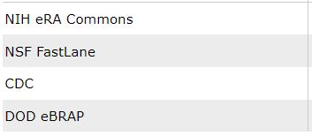
START Changes and Updates
Planning Upgrade: April 2024 – Stay tuned!
System Messages – communication of changes
Added ability to store DOD eBRAP credentials
Addition of field on data collection form
Opportunity to add notes to SPA/reviewers (non-mandatory)
Configured reminders for COI Certification Form
Remember that Financial Disclosures are required when someone is marked as Key/Responsible on Personnel tab
Non-Assignment based – emails are delivered through COI office needs
Project Certifications form are triggered when someone is “responsible” and when project moves toward a funding status
Emails are sent out and an assignment is generated (through COI module)

Slide 27
Q & A

